Slide 1
Work Breakdown Structure
Lecturer: Ngo Huy Bien
Software Engineering Department
Faculty of Information Technology
VNUHCM - University of Science
Ho Chi Minh City, Vietnam
nhbien@fit.hcmus.edu.vn

Slide 2

Objectives
To create a work breakdown structure.
To calculate an effort estimate.

Slide 3

Contents
Work breakdown structure.
Effort estimation.

Slide 4

References
Project Management Institute (2017). A Guide to the Project Management Body of Knowledge. Sixth Edition. Project Management Institute.
Roger S. Pressman and Bruce R. Maxim (2015). Software Engineering - A Practitioner’s Approach. 8th Edition. McGraw-Hill.
Bertrand Meyer (1997). Object Oriented Software Construction.
Project Management Institute (2006). Practice Standard for Work Breakdown Structures. Project Management Institute.
Eric S. Norman, Shelly A. Brotherton and Robert T. Fried (2008). Work Breakdown Structures - The Foundation for Project Management Excellence. John Wiley & Sons.

Slide 5


When Will You Complete Your Work?

Slide 6
Work Breakdown Structure [1]
The WBS is a hierarchical decomposition of the total scope of work to be carried out by the project team to accomplish the project objectives and create the required deliverables.
Project
Documents
Application
User guide
Compilation guide
Feature 1
Feature 2
Use Cases / User Stories
Source Code
Use Cases / User Stories
Source Code

Slide 7
How to Create WBS (Round 1)?
Input - Vision and scope document, PoC, other documentation and systems
Repeat identifying, judging, discussing deliverables, work and removing duplicates
Output - Work breakdown structure (WBS).
Assumptions
Actual performance

Slide 8
Product Decomposition
Product
Documents
System
Graphics
…
Executive summary
Project vision
…
Data
…
Icons
UIs
…
Source code

Slide 9
System Decomposition
Portal
Authentication
Login
Forgot password
Authorization
Roles
Users
Theme
Module theme
System theme
User’s theme
System
Modules
Features

Slide 10

Features Decomposition
Features
Manage Customers
Manage Employees
Reports
…
CRUD
Manage Feedback
…
Manage Salaries
…
Generate reports
Filter information
…
CRUD
Granularity?

Slide 11
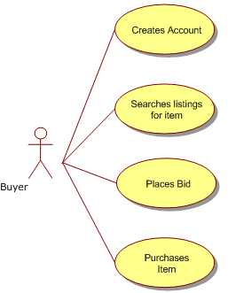
Use Case Decomposition
Database schema.
UIs.
Class diagram, sequence diagram, flow chart, state chart, algorithm description, solution description.
Source code (including unit tests).
Test cases, test report.
User guide, development guide,
deployment guide.
Meeting minutes, chat scripts.

Slide 12
Work Decomposition
Plan
Requirements specification
Solution description
Result
Review minutes
Guides
Management documents
Communication documents
Plan
Create/Do
Manage
Review/Test
Rework
Report

Slide 13
Phases Decomposition (I)
Deliverables
Project
Planning
Requirement engineering
Design
Construction
Executive summary
Project vision
…
Software requirements
…
Architecture design
Detailed design
…
User requirements
…
Coding
Unit testing
Integration guide

Slide 14
Phases Decomposition (II)
Project
Testing
Test plan
Inspection report
Deployment
Packages
Test report
Training materials
Support ticket
Support
…
Issue tickets
Documentation
User guide
Installation guide
Development guide
Updated packages
Deliverables

Slide 15
Common Activities Decomposition
Deliverables
Activities
Staffing
Job descriptions
Interview minutes
Candidate review guide and report
Environment
Tools
Configuration management plan
Schedules
Monitoring reports
Status reports
Communication
Meeting minutes
Emails
Phone call logs
Training materials
Management

Slide 16
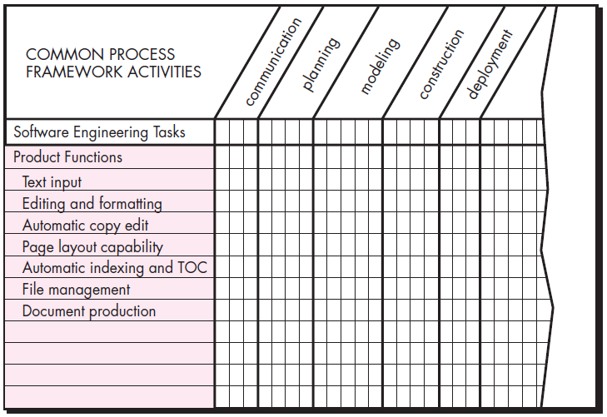
Melding the Product and the Process [2]
Deliverables

Slide 17
Top-Down [3]
Top-down is a reasonable way of describing things which are already fully understood.
When the top-down phase begins, the problem is already solved, and only details remain to be solved.
Authentication
Account creation
Email/Password
Social account
Login
Email/Password
^{1st} round
2nd round
^{3rd} round
SSO
...

Slide 18

Bottom-Up

Slide 19

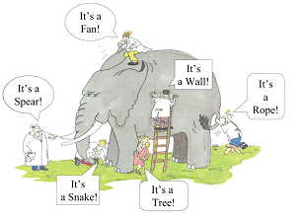

How to Create WBS (Round 2)?
Input - Vision and scope document, PoC other documentation and systems
Repeat identifying, judging, discussing deliverables, work and removing duplicates
Output - Work breakdown structure (WBS) + Effort estimates for each of the tasks in the WBS. Granularity?
Unclear Software Requirements!

Slide 20

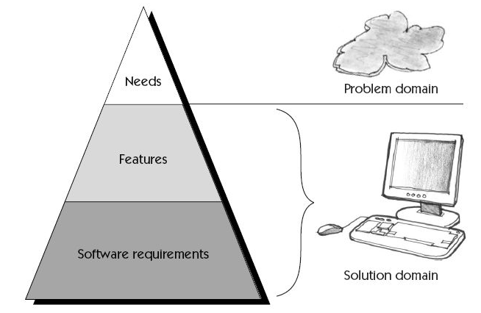
Revisiting Prototype

Slide 21


Requirements Engineering Decomposition
Meeting minutes, chat scripts.
UIs.
Domain model.
Data model.
Software requirement specification (use cases, business rules, usability, operation, environment, security, documentation, programming languages, technologies, constrains).
Review minutes.

Slide 22

How to Create WBS (Round 3)?
Input - Vision and scope document, PoC, SRS, other documentation and systems
Repeat identifying, judging, discussing deliverables, work and removing duplicates
Output - Work breakdown structure (WBS) + Effort estimates for each of the tasks in the WBS. Granularity?
Unclear Solution!

Slide 23


Revisiting Proof of Concept

Slide 24

Solution Engineering Decomposition
Investigation notes.
Design specification (architecture, system components, technologies, 3rd party components, database model, algorithms and patterns).
Exercise source code.

Slide 25

Why WBS?
Better communication to project sponsors, stakeholders, and team members by providing a structured vision of what has to be delivered.
Increased confidence that 100% of the work (scope) is identified and included.
More accurate estimation of tasks, risks, timelines, and costs.
A foundation for the control processes within the project.

Slide 26

Pitfalls
Excessive decomposition can lead to
nonproductive management effort,
inefficient use of resources,
decreased efficiency in performing the work, and
difficulty aggregating data over different levels of the WBS.

Slide 27



How Big is Your Project?
Actually, WBS only answers the question “When will you complete your project if there is only you working on the project?”
Effort = staff × time

Slide 28


Slide 29

Deliverable [4]
Any unique and verifiable product, result, or capability to perform a service that must be produced to complete a process, phase, or project.
Often used more narrowly in reference to an external deliverable, which is a deliverable that is subject to approval by the project sponsor or customer.

Slide 30
WBS Element
WBS Element. Any single work breakdown structure (WBS) component and its associated WBS attributes contained within an individual work breakdown structure.
Project
Documents
Application
User guide
Compilation guide
Feature 1
Feature 2
Use Cases / User Stories
Source Code
Use Cases / User Stories
Source Code

Slide 31
Work Package
A deliverable or project work component at the lowest level of each branch of the work breakdown structure.
The work package includes the schedule activities and schedule milestones required to complete the work package deliverable or project work component.
Project
Documents
Application
User guide
Compilation guide
Feature 1
Feature 2
Use Cases / User Stories
Source Code
Use Cases / User Stories
Source Code

Slide 32
Control Account
A management control point where scope, budget (resource plans), actual cost, and schedule are integrated and compared to earned value for performance measurement.
Control accounts are placed at selected management points (specific components at selected levels) of the work breakdown structure.
Each control account may include one or more work packages, but each work package may be associated with only one control account.
Project
Documents
Application
User guide
Compilation guide
Feature 1
Feature 2
Use Cases / User Stories
Source Code
Use Cases / User Stories
Source Code

Slide 33

The 100% Rule
This rule states that the WBS includes 100% of the work defined by the project scope and captures ALL deliverables—internal, external, and interim—in terms of work to be completed, including project management.
The rule applies at all levels within the hierarchy: the sum of the work at the ‘‘child’’ level must equal 100% of the work represented by the ‘‘parent’’ and the WBS should not include any work that falls outside the actual scope of the project, that is, it cannot include more than 100% of the work.

Slide 34
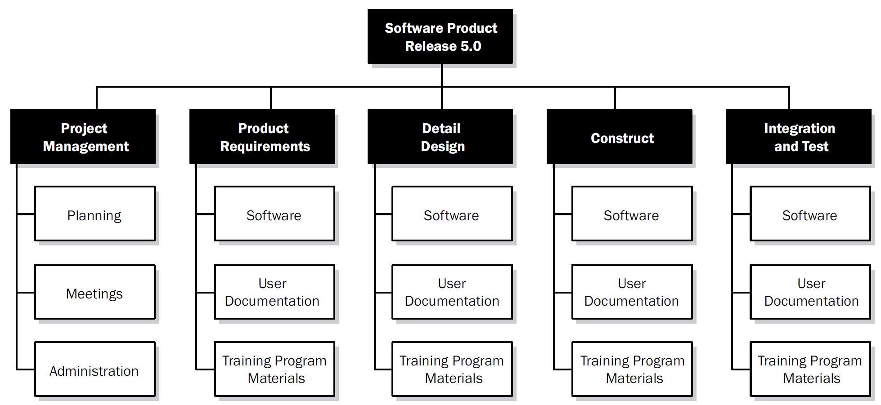
Activity & Task
Activity. A component of work performed during the course of a project.
Task. A term for work whose meaning and placement within a structured plan for project work varies by the application area, industry, and brand of project management software.
The WBS structure can be represented using phases of the project life cycle as the second level of decomposition, with the product and project deliverables inserted at the third level.

Slide 35
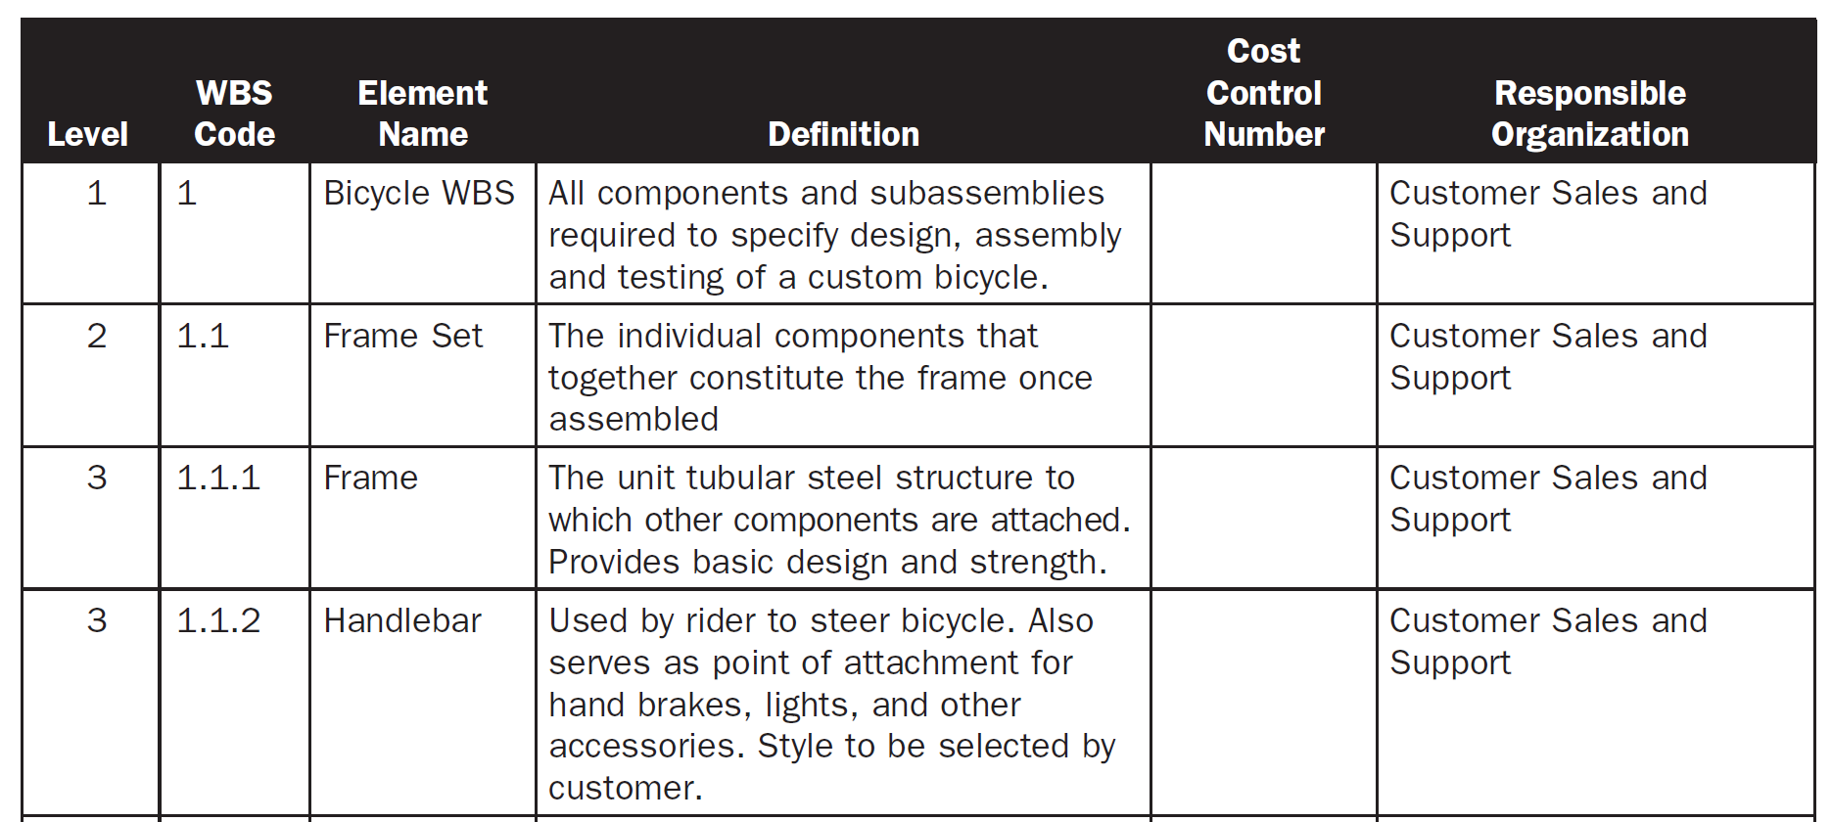
WBS Dictionary
The WBS dictionary defines, details, and clarifies the various elements of the WBS to ensure that each component of the WBS is accurately articulated and can be communicated to anyone referencing the WBS.
The WBS dictionary contains information about each element of the WBS, including a detailed description of the work, deliverables, activities, and milestones associated with each element.
WBS Dictionary

Slide 36
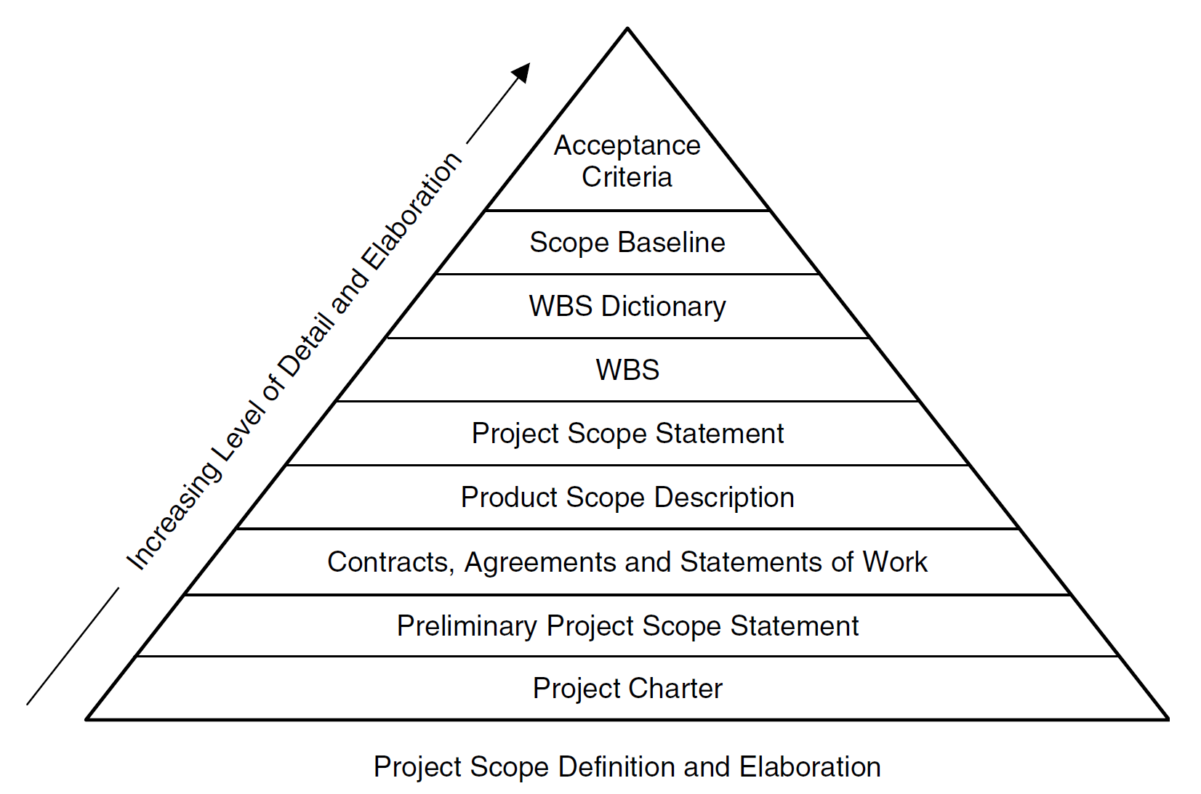
Project Initiation and The WBS [5]

Slide 38

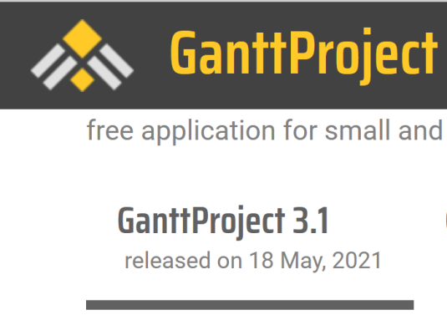
Tools for WBS
https://products.office.com/en-au/Project/project-for-office-365
https://www.ganttproject.biz/download/free
https://ganttpro.com/
https://www.smartsheet.com/

Slide 39

Further Reading
Project Management Institute (2006). Practice Standard for Work Breakdown Structures. Project Management Institute.
Eric S. Norman, Shelly A. Brotherton and Robert T. Fried (2008). Work Breakdown Structures - The Foundation for Project Management Excellence. John Wiley & Sons.

Slide 40

Thank You & See You Again

